Slide 1


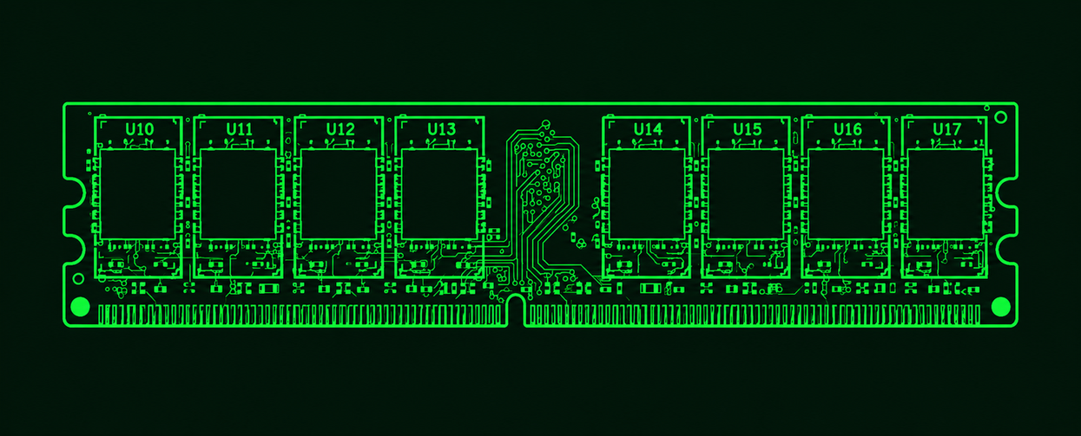
>RAM
Miriam Portales Ortiz
Notes:
1.7.2013
1
‹#›

Slide 2
>TABLE OF CONTENTS
01
Introduction
02
Types of memory
03
How RAM works
04
Memory pyramid
05
CPU and motherboard
06
DDR4 vs DDR5
07
DIMM, SO-DIMM and RAM kits
08
Kahoot quiz

Slide 3
>INTRODUCTION
RAM = Random Access Memory
What is RAM?
RAM is the main memory of a computer.
What does it store?
The data and instructions the CPU is using right now: the operating system, open programs and files you edit.
Why is it fast?
It is much faster than a storage drive (HDD or SSD), so the CPU does not wait for the disk.
Why more RAM?
The more RAM a computer has, the more programs it can run at the same time.

Slide 4


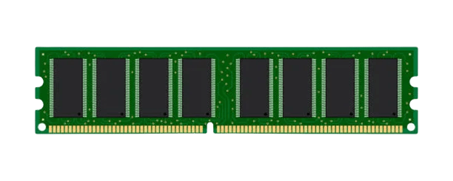
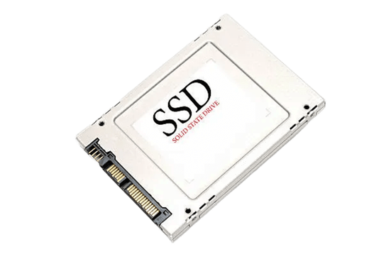
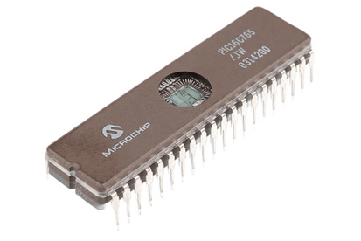
>VOLATILE VS NON-VOLATILE MEMORY
Volatile
Loses its information when the computer turns off.
Stores what the CPU needs quickly while programs are running.
Examples: RAM, cache
Non-volatile
Keeps its information when the computer turns off.
Stores data and instructions for the long term.
Examples: ROM, SSDs
Notes:
1.7.2013
2
‹#›

Slide 5

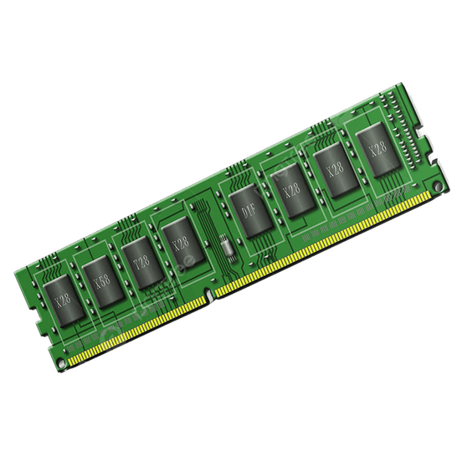
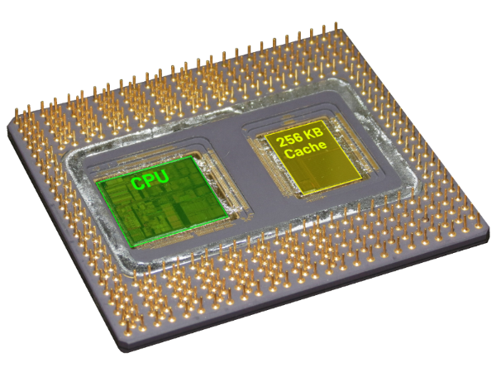
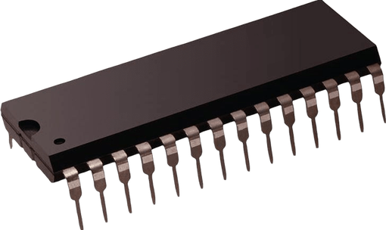
>RAM, CACHE AND ROM
They differ in volatility, speed and function.
RAM
Volatile. Stores data and instructions for immediate execution. More capacity helps multitasking.
Cache
Volatile. Keeps copies of frequently used RAM data so the CPU works faster. Faster than RAM, but smaller.
ROM
Non-volatile. Its content is not easily changed by the user. Stores start-up instructions and basic hardware settings.
Notes:
1.7.2013
3
‹#›

Slide 6
>HOW RAM WORKS
1. Open a program
The operating system copies it from the drive (slow, non-volatile) into RAM (fast, volatile).
2. Work
The CPU reads instructions and data from RAM and writes the results back.
3. Close or turn off
When you close the program or turn off the computer, the RAM is cleared.
4. Not enough RAM?
The system uses part of the drive as virtual memory, and the computer becomes much slower.

Slide 7
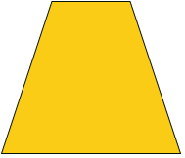


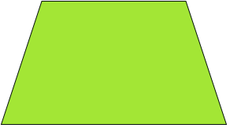

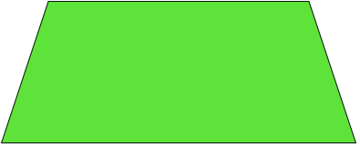

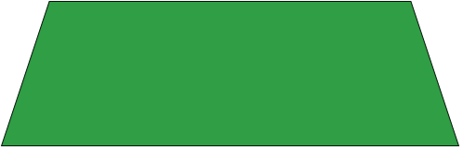

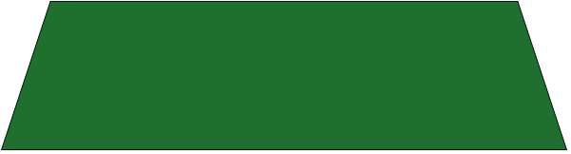

>PYRAMID MEMORY
CPU
Register
Level 0 – CPU Registers
The fastest and smallest memory. Inside the CPU, it holds the data in use right now.
Level 0
Cache
Level 1 – Cache Memory
Very fast memory close to the CPU. Stores frequently used data.
Level 1
Main
Memory
Level 2 – Main Memory (RAM)
Holds the programs and data in use right now. Faster than disks, but loses its data when turned off.
Level 2
Magnetic
Disk
Level 3 – Magnetic Disk
HDDs store files, programs and the operating system. More capacity than RAM, slower, keeps data when turned off.
Level 3
Magnetic Tape
Optical Disk
Level 4 – Magnetic Tape and Optical Disk
Tapes, CDs and DVDs store or back up data. Slow to access, but keep data for a long time.
Level 4
Top: faster, smaller. Bottom: slower, bigger.
Notes:
1.7.2013
8
‹#›

Slide 8
>CPU AND RAM
The CPU talks to RAM through the memory controller, which is inside the processor. So the CPU decides which memory the computer can use.
Memory type
A CPU can support DDR4, DDR5 or both, depending on the model.
Speed and channels
Each CPU has a maximum memory speed and a number of channels it supports. Faster RAM works at higher speeds only with profiles like XMP or EXPO.
Cache
The CPU keeps copies of the most used RAM data in its cache (L1, L2, L3), so it does not wait for RAM every time.

Slide 9
>MOTHERBOARD AND RAM
RAM modules go in the DIMM slots of the motherboard, so both must be compatible.
DDR generation
A DDR4 module does not fit in a DDR5 slot because the notch is in a different position. Buy RAM of the same generation as the motherboard.
Number of slots
Motherboards usually have 2 or 4 slots. Each one has a maximum total capacity.
Dual channel
The slots work in pairs. For dual channel, install the modules in the correct slots (the manual shows which).
Chipset and BIOS/UEFI
They define the supported speeds. In the BIOS/UEFI you can turn on the XMP or EXPO profile of the RAM.

Slide 10
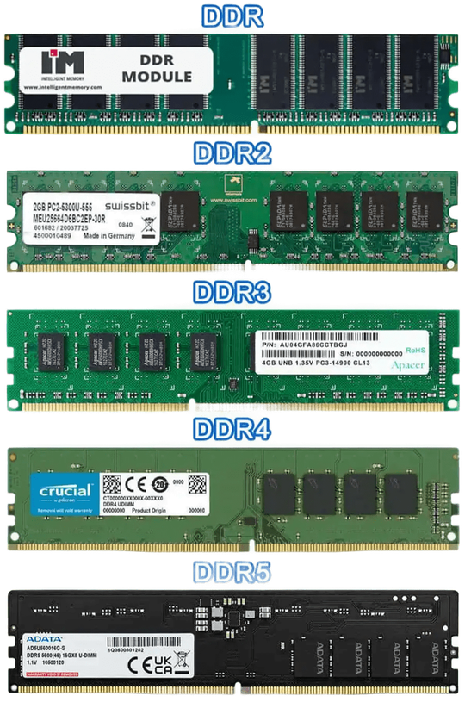
>DDR4 VS DDR5
MT/s = million transfers per second. A lower CL means a faster response, but speed also matters, so a lower number is not always faster. Dual channel uses two channels instead of one, giving more bandwidth and performance.
DDR4
DDR5
It is an older type of RAM. It is fast and works well for everyday tasks and games. It uses less power than older memory types.
It is a newer type of RAM. It can transfer data faster and offers more memory capacity. It is more energy-efficient than DDR4.
Capacity
Physical differences
They both have different capacities like 8 GB, 16 GB, 32 GB, but DDR5 can support higher capacities per module.
The notch is in a different position on DDR4 and DDR5. This stops you from inserting the wrong type of memory and makes you install it in the correct direction.
Notes:
1.7.2013
4
‹#›

Slide 11
>DDR4 VS DDR5 IN DETAIL
More details about DDR4 vs DDR5
Capacity
Frequency
Voltage
Both come in 8, 16 and 32 GB modules, but DDR5 can reach higher capacities per module.
Measured in MT/s (shops often write MHz). DDR4 is usually around 3200 MT/s. DDR5 is faster: 6400 MT/s or more.
DDR4 works at 1.2 V and DDR5 at 1.1 V, so DDR5 uses less power.
Latency
Single vs dual channel
How long the RAM takes to respond. DDR4: CL16 to CL22. DDR5: CL30 to CL40. DDR5 has a higher CL, but also a higher speed, so the real latency is similar (about 10 ns vs 12.7 ns). Real latency in ns = CL × 2000 / MT/s.
Dual channel uses two channels at the same time, giving more bandwidth and performance. DDR4 has one 64-bit channel per module and DDR5 has two 32-bit subchannels.

Slide 12


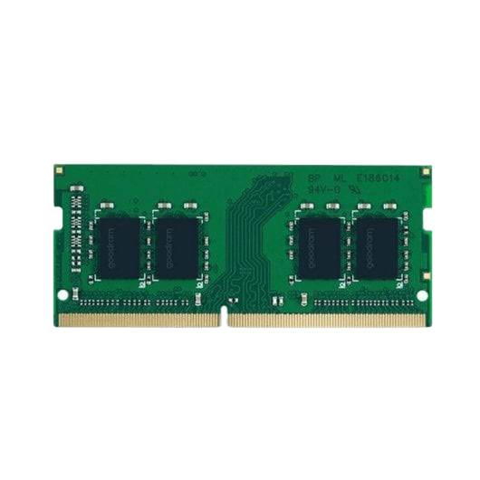
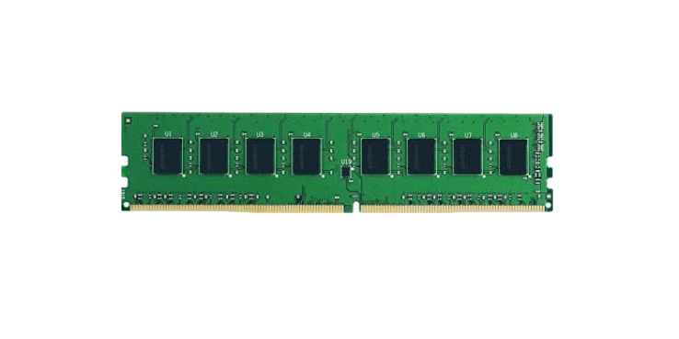
>DIMM VS SO-DIMM
DIMM
Bigger. Used in desktop computers, which have more space inside.
DDR4: 288 pins · DDR5: 288 pins
SO-DIMM
Smaller. Used in laptops, which have less space inside.
DDR4: 260 pins · DDR5: 262 pins
They work the same way: both store data and help the computer run programs. The difference is their size, and performance depends on speed and other specifications.
Notes:
1.7.2013
5
‹#›

Slide 13


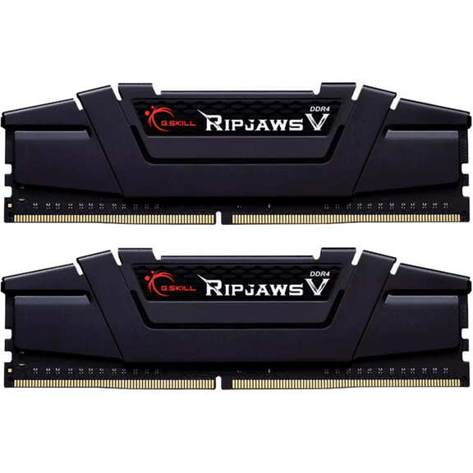
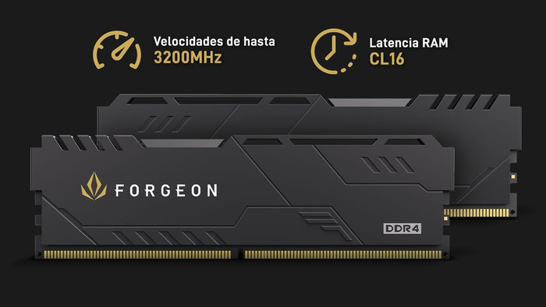
>RAM KITS: DDR4
Forgeon Cyclone PLUS V2 DDR4
Capacity: 16 GB (2×8 GB)
Frequency: 3200 MHz
Latency: CL16
149.90€
G.Skill Ripjaws V DDR4
Capacity: 32 GB (2×16 GB)
Frequency: 3600 MHz
Latency: CL18
261.99€
Notes:
1.7.2013
6
‹#›

Slide 14


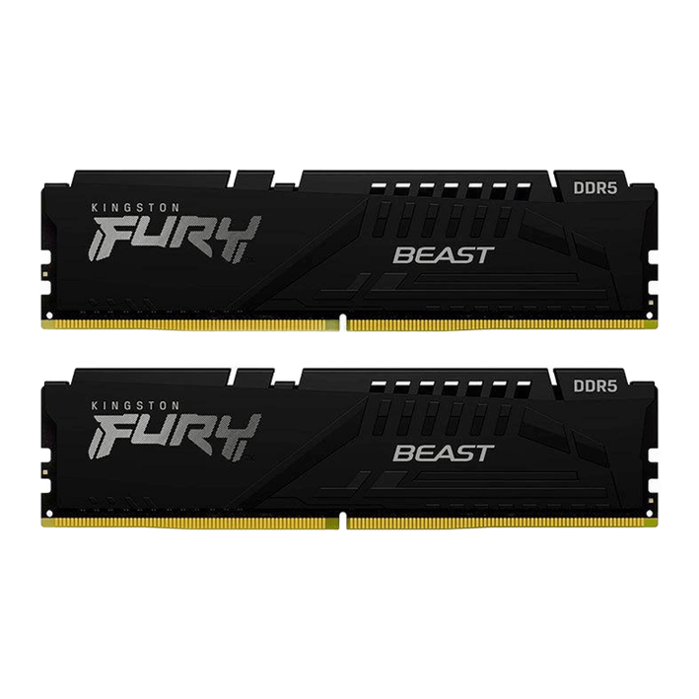
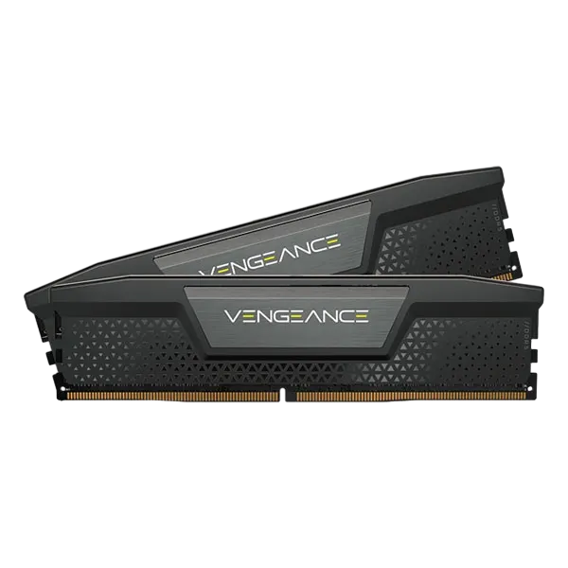
>RAM KITS: DDR5
Kingston FURY Beast DDR5
Capacity: 32 GB (2×16 GB)
Frequency: 5600 MHz
Latency: CL36
€629.90
Corsair Vengeance DDR5
Capacity: 32 GB (2×16 GB)
Frequency: 6000 MHz
Latency: CL38
€542.90
Notes:
1.7.2013
7
‹#›

Slide 15
>KAHOOT QUIZ
Test what you learned!
Play my quiz here:
https://create.kahoot.it/share/ram-test/7a3f937f-a1da-4a97-8288-bdef654acedf

Slide 16
>THANKS!
Thank you for your attention
Notes:
1.7.2013
9
‹#›

